Slide 1

Card Helper
BY: blade Arnold
Human Computer interaction

Slide 2
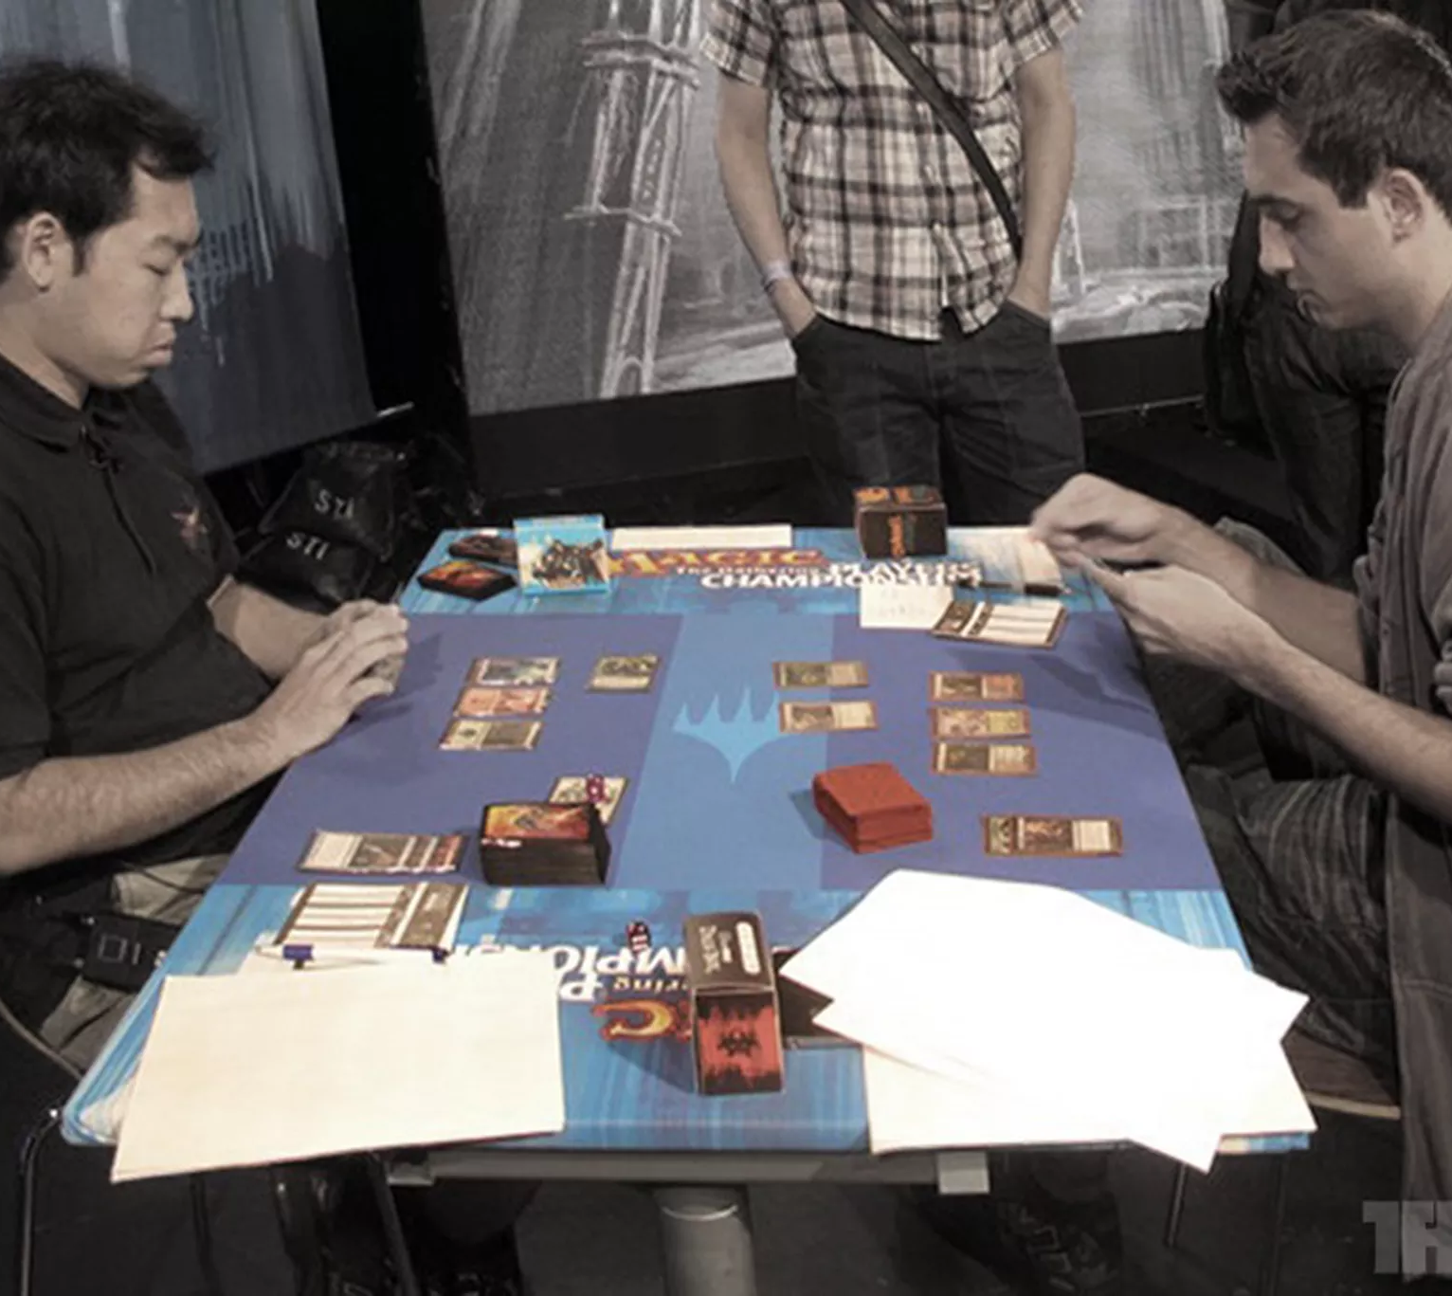
Project Goals / Concept Description
The whole goal of the project was to help people who play multiple card games.
This app will be able to help the user keep track of the card games, the card details, and the news associated with the card games.
The app helps solve the “overload of information” problem by displaying the best decks in the format on the app, by showing ban lists, and by reporting news for the game.

Slide 3
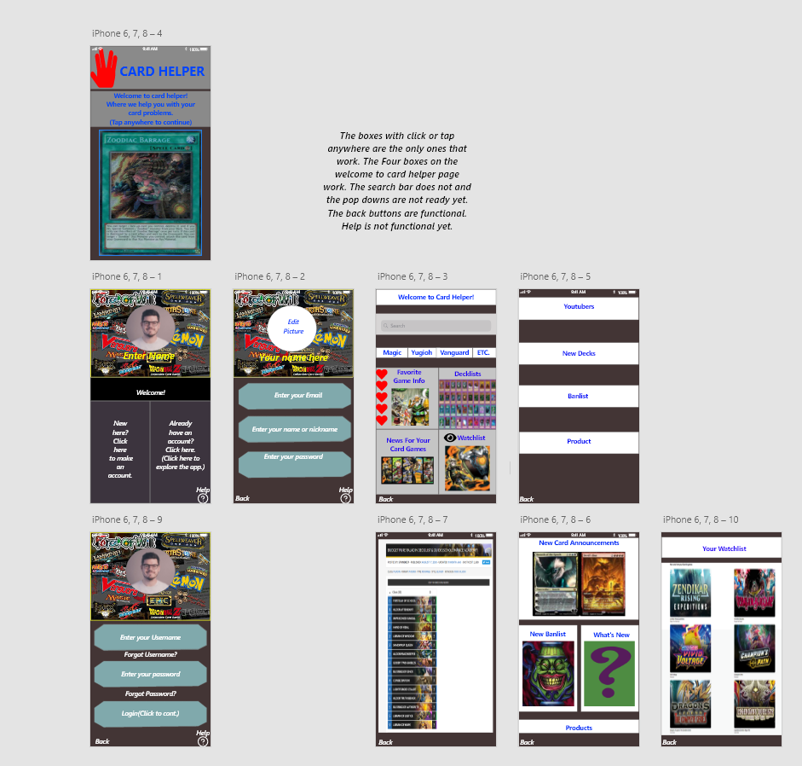
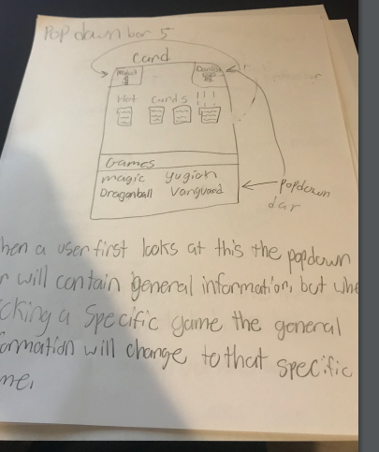
Overview of Development Path
For the first step of the development process, I created sketches of my ideas.
The first sketches were used as a starting point, but they were not implemented into the app.
The second step was to create the app by using Adobe XD.
As I developed the first version of the app, most of the sketches were discarded. The layout of the app began to develop as I experimented with color and layout in Adobe XD.
When I completed the first version of the app, I was really impressed with it.

Slide 4
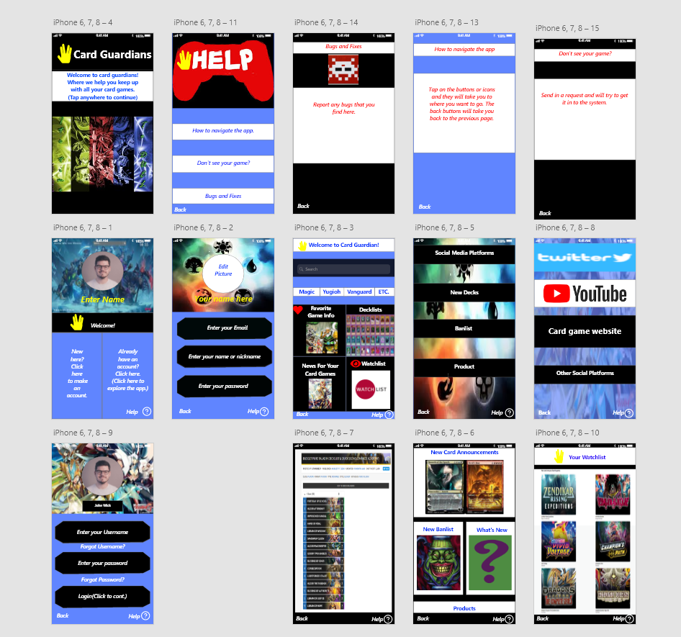
Overview of Development Path: Part 2
While creating the final version of the app, I saw the transformation of the app from the sketches to the prototype I am submitting.
The differences were:
more functions,
Better pictures,
and different and more harmonized color schemes.
The fourth step was to ask for feedback from users so I could improve the app.
And the fifth step was to implement the results of the survey.

Slide 5
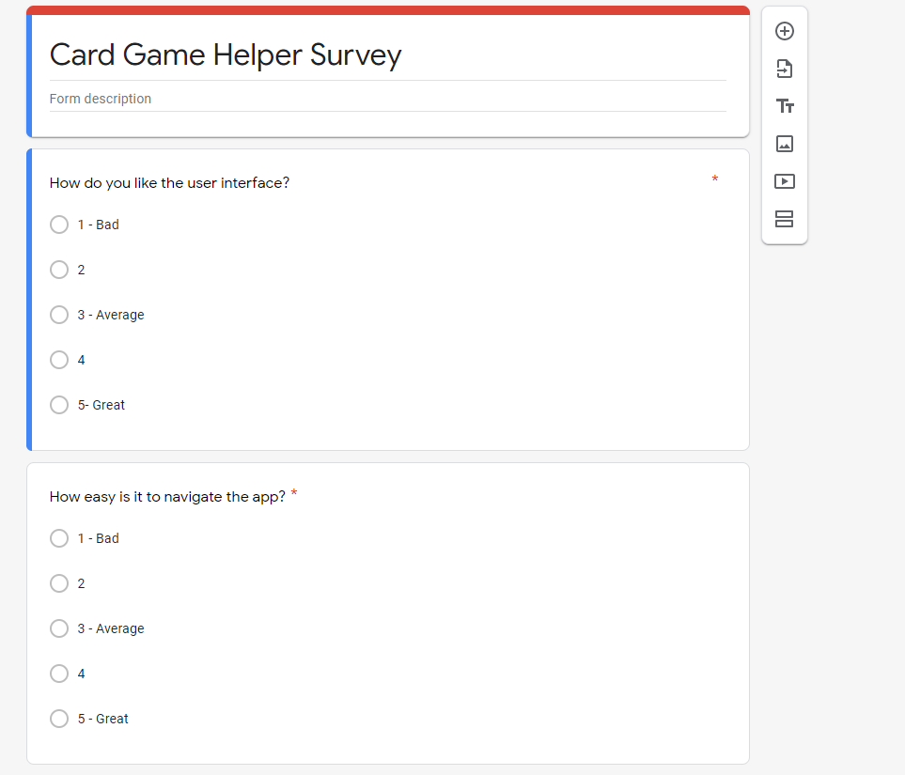
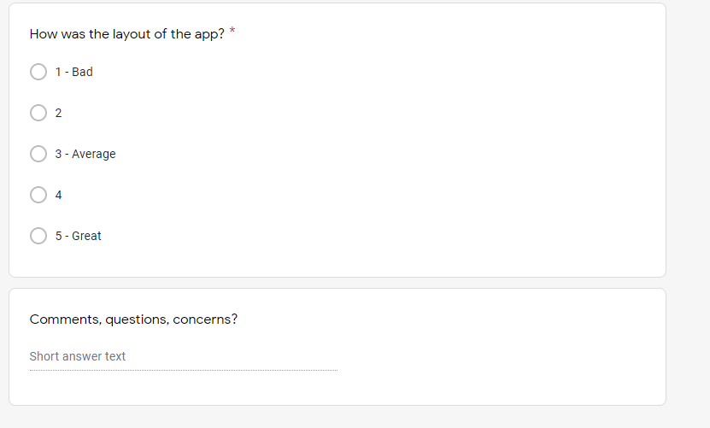
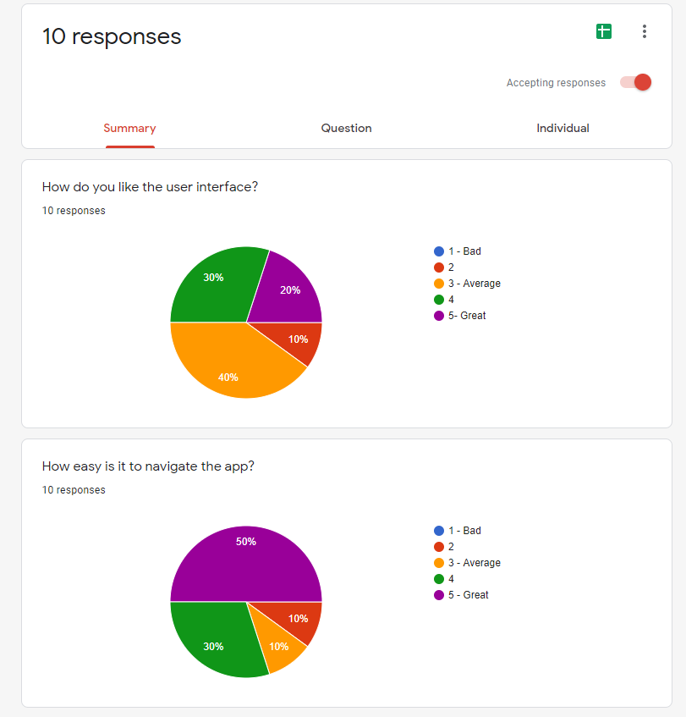
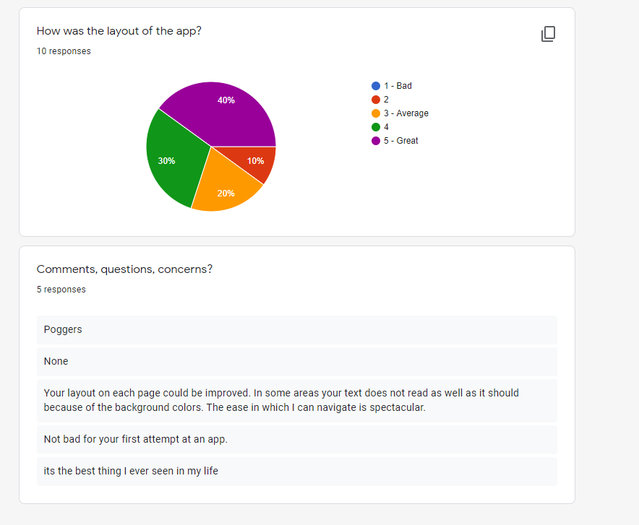
Details of User Evaluation
I used Google Forms to create a survey so that the users could evaluate my app.
Using a Likert scale, ranging from one to five with one being bad and five being great, I asked the users to rate their experience.
The three Likert scale questions asked about the user interface, the layout, and the ease of moving through the app.
One question asked for comments, questions, and concerns and was an open-ended question.
The results from the survey was used to fix my color scheme and some design problems that were exposed.

Slide 6
The Technology Used for the Final Interface
Adobe XD was used to create the app.
I implemented some design techniques that I learned from YouTube. A lot of experimentation was used. After playing around with the colors and getting user feedback, I created new color schemes. I created one scheme that most of them liked. Also, I did have to find a color scale and compare colors on them to make sure that they matched.

Slide 7
Demo
Provide a live demonstration of your final interface(s)/prototype(s)
https://xd.adobe.com/view/2e9019fb-8eb1-4c79-9f40-3851bef351a7-7bc3/

Slide 8
Total Time: 3 - 7 minutes
Your recorded presentation should last between three and seven minutes. (Group presentations may last up to 15 minutes if necessary.)

